Slide 1
Neural Networks: Basics and Architectures
PRESENTATION BY:
SUMAN PAUDEL (33) MDS 501

Slide 2
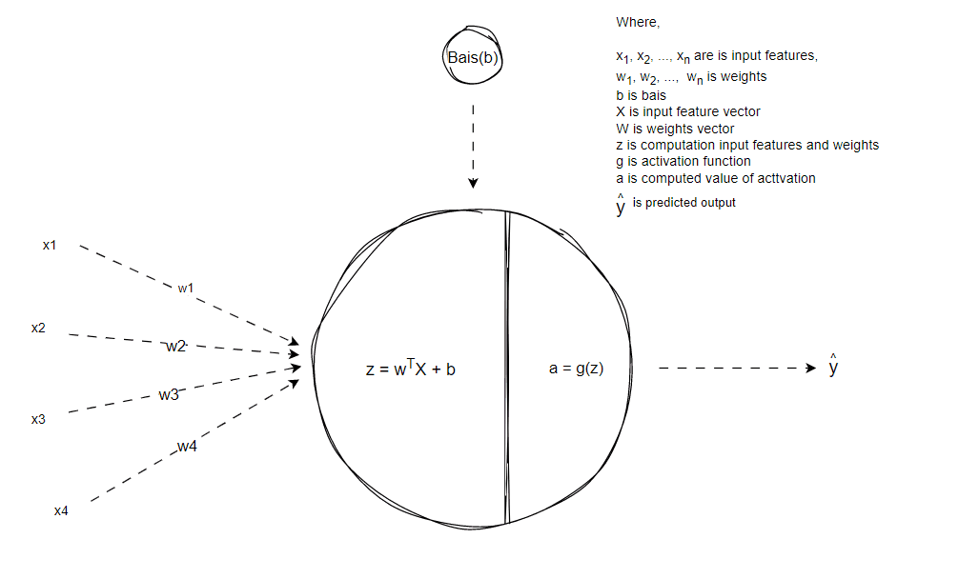

Inspiration OF NEURAL Network

Slide 3
NEURAL Network
A neural network is a machine learning program, or model, that makes decisions in a manner similar to the human brain, by using processes that mimic the way biological neurons work together to identify phenomena, analyze options and arrive at conclusions.
Neural networks were first proposed in 1944 by Warren McCullough and Walter Pitts in the paper “The Logical Calculus of the Ideas Immanent in Nervous Activity on how neurons might work”.

Slide 4
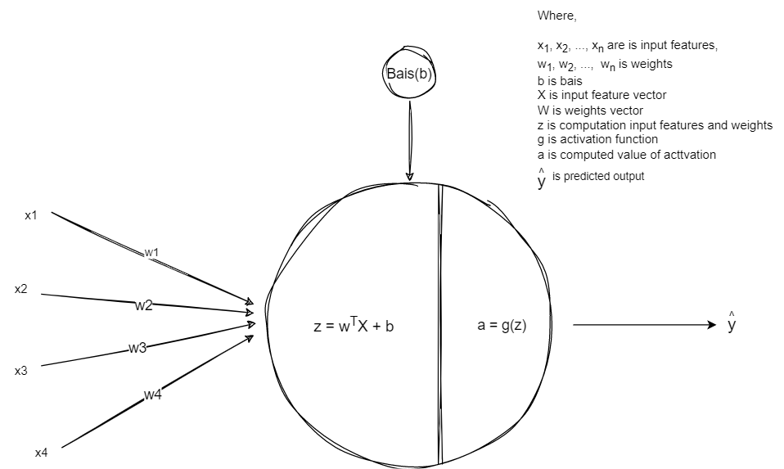
KEY Terminologies used in Neural NETWORK
Neuron: The fundamental building block of a neural network, inspired by the biological neurons in the human brain.
Activation Function: A mathematical function that determines the output of a neuron based on its input. Common activation functions include sigmoid, ReLU, tanh, and softmax.
Weights: The numerical parameters that determine the strength of the connections between neurons.
Bias: An additional parameter added to the weighted sum of a neuron's inputs to shift the activation function in accordance with realistic expectations.

Slide 5
KEY Terminologies used in Neural NETWORK CONTD…
Input Layer: The first layer of a neural network that receives the input data.
Hidden Layer: The intermediate layers between the input and output layers, where the network learns to extract features and representations.
Output Layer: The final layer of a neural network that produces the predicted output.
Feedforward: The process of propagating the input data through the network layers to produce the output.
Backpropagation: The algorithm used to train neural networks by propagating the error from the output layer back through the network to update the weights and biases.

Slide 6
KEY Terminologies used in Neural NETWORK CONTD…
Loss Function: A function that quantifies the difference between the predicted output and the true output, which is minimized during the training process.
Gradient Descent: An optimization algorithm used to update the weights and biases of a neural network by iteratively moving in the direction of the negative gradient of the loss function.

Slide 7
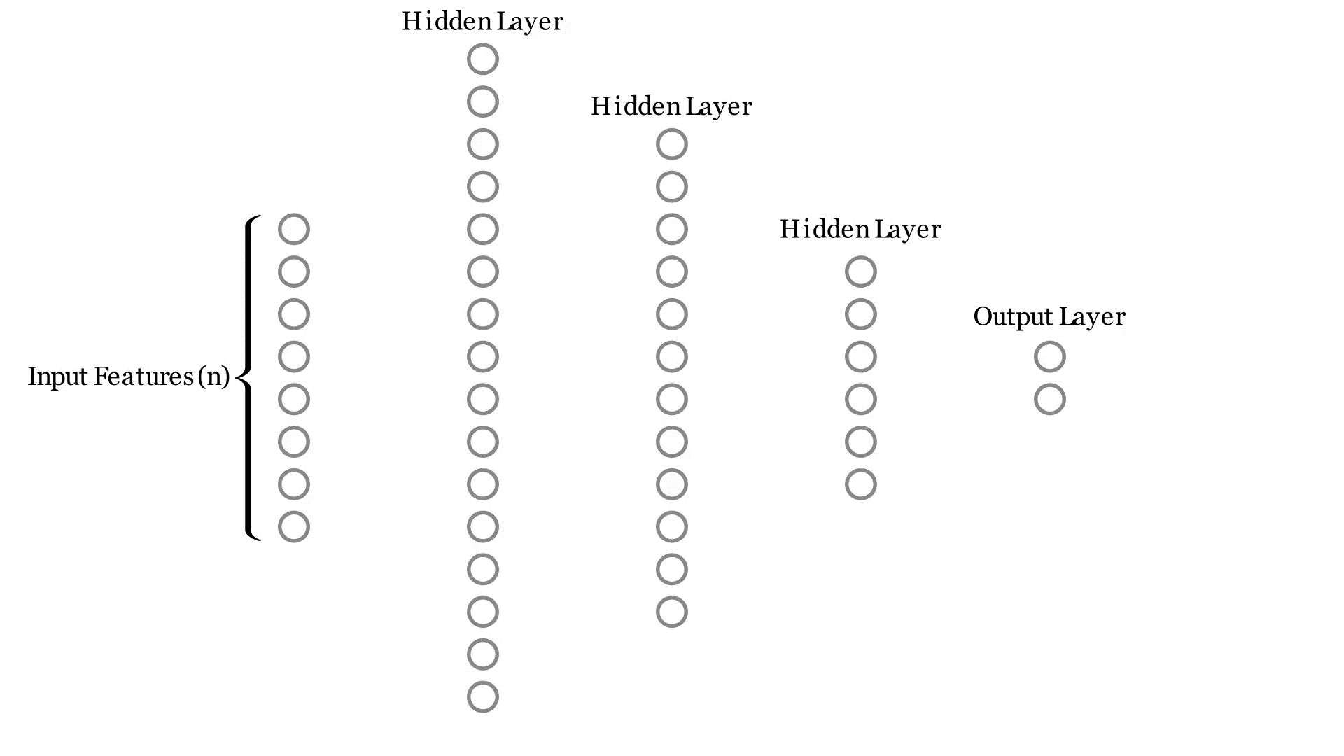
Visualizing Neural network FORWARD Propagation/FEED FORWARD

Slide 8
Visualizing Neural network BACKWARD Propagation

Slide 9
Visualizing Neural network FORWARD Propagation after update

Slide 10
NEURAL Network Architectures
Single Layer Network (Binary Classification/Regression)
Multilayer Perceptron or Feedforward Network (Normal Tasks)
Convolutional Neural Network (CNN) (Image Processing/Object Detection)
Recurrent Neural Network (RNN) (Audio/Time Series Processing)
Generative Adversarial Network (GAN) (Style transfer, DeepFakes)
Autoencoders (dimensionality reduction, feature extraction)
Transformer (ChatGPT, GPT 4, Gemini, Claude 3, Llama 3, Mistral Large)

Slide 11
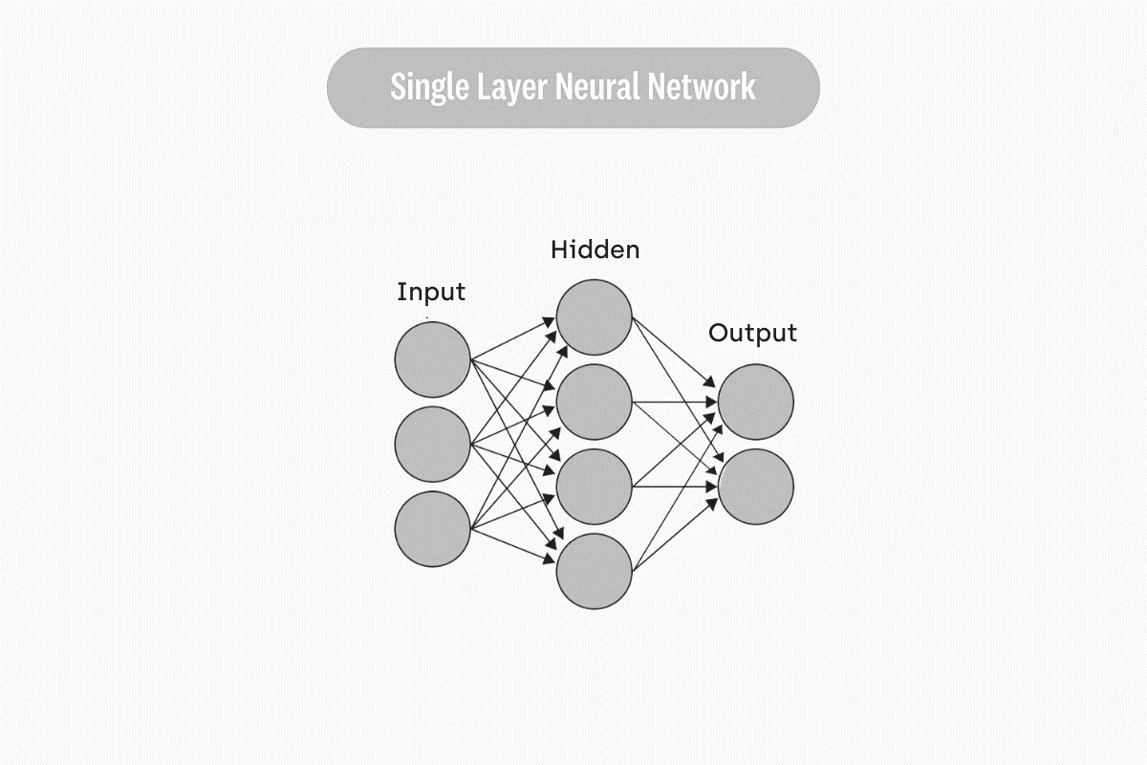
SINGLE LAYER NETOWRK ARCHITECTURE
USE CASE/Applications:
Binary Classification
Regression such as sales Predictions.

Slide 12
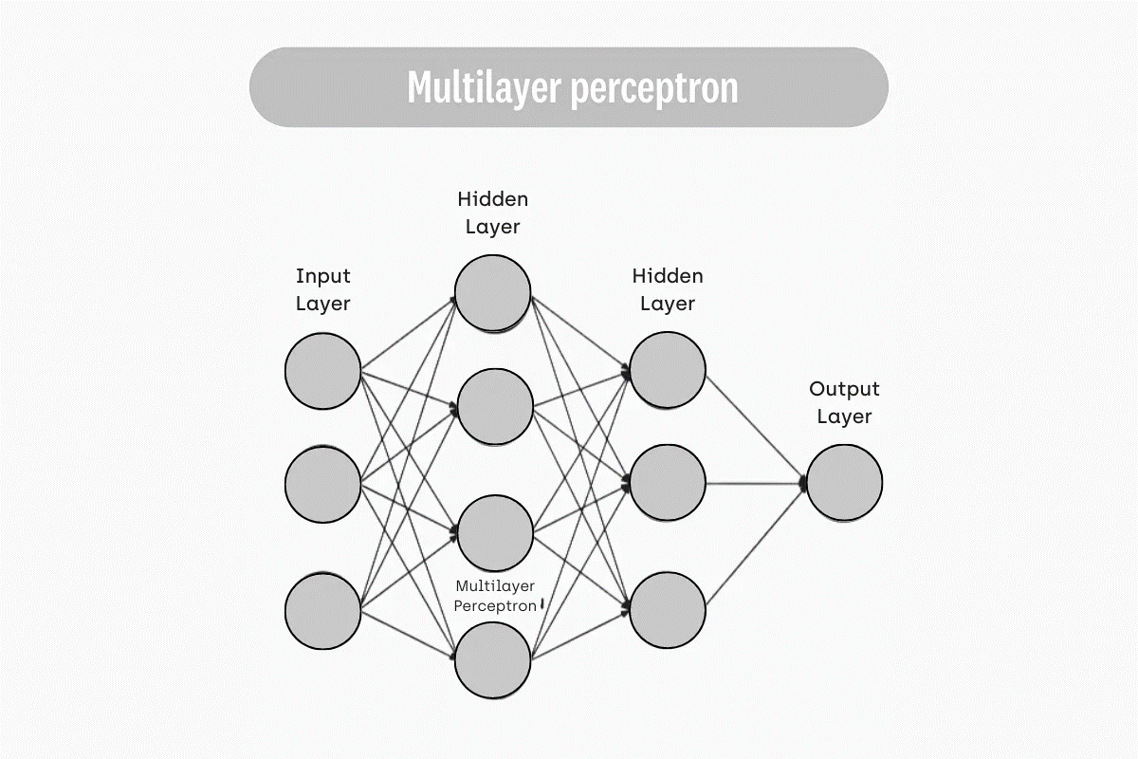
MULTI LAYER NETOWRK ARCHITECTURE
USE CASE/Applications:
Speech Recognition
Classifications
Recommender Systems
Predictions
Sentiment analysis

Slide 13
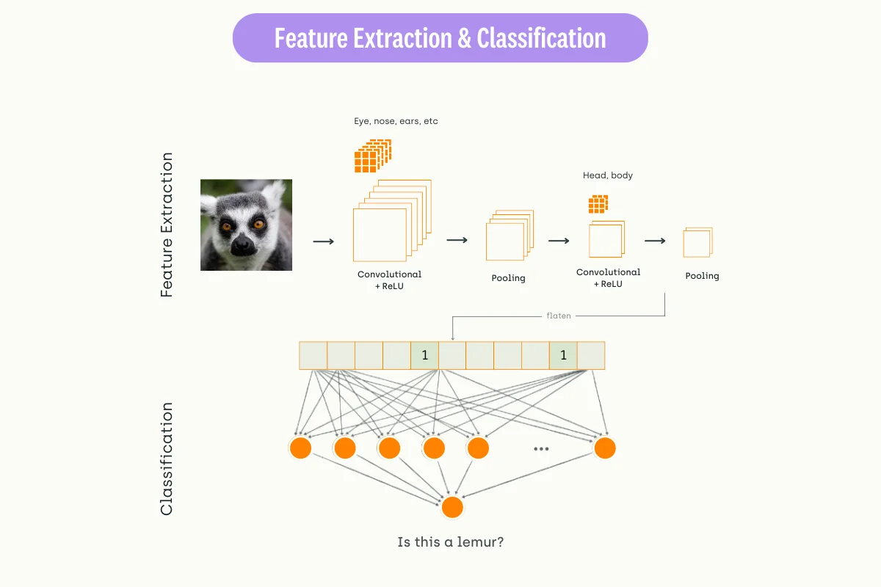
Convolutional Neural Network
(CNN) ARCHITECTURE
Famous Neural Network Architecture for Image Processing/Classification/Object Detection/Recognition
Common Architectures of CNNs are:
AlexNet
LeNet
ResNet
YOLO
VGG – 16
InceptionNet
Example: Image Classification

Slide 14
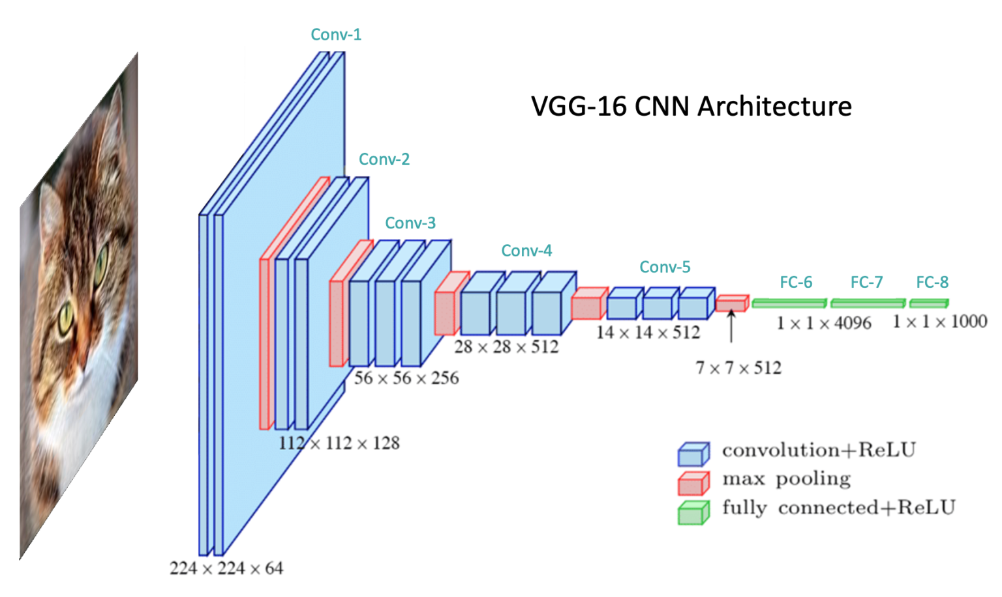
CNN VGG -16 Architecture

Slide 15
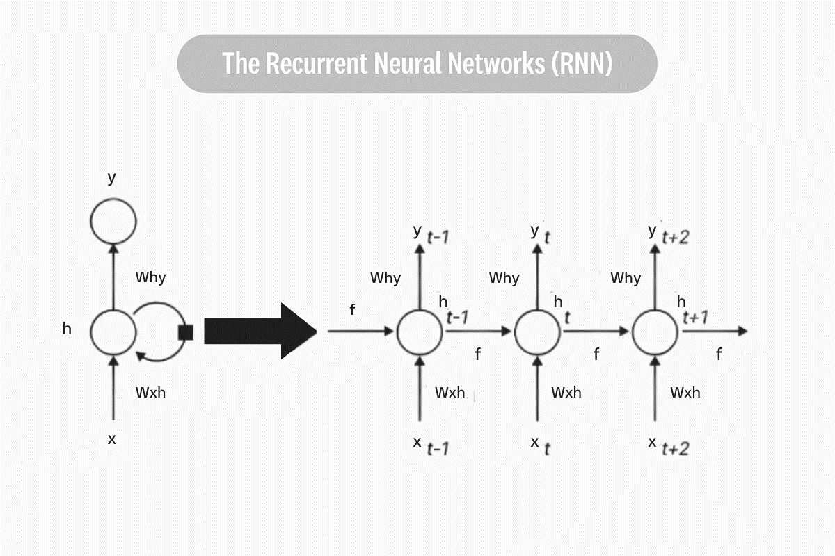
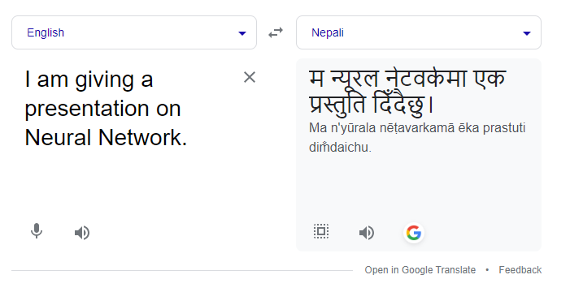
Recurrent Neural Network (RNN)
State-ot-the-art neural network at the time, capable of remembering its past decision with higher accuracy.
USE CASE/Application:
Very useful for sequential data, such as speech, text, or video. Speech Recognition like (Google or Siri)
Text Summarization
Machine Translation

Slide 16
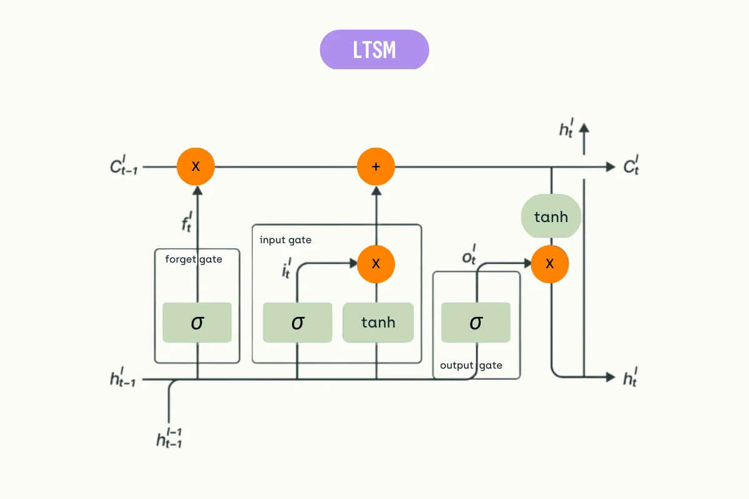
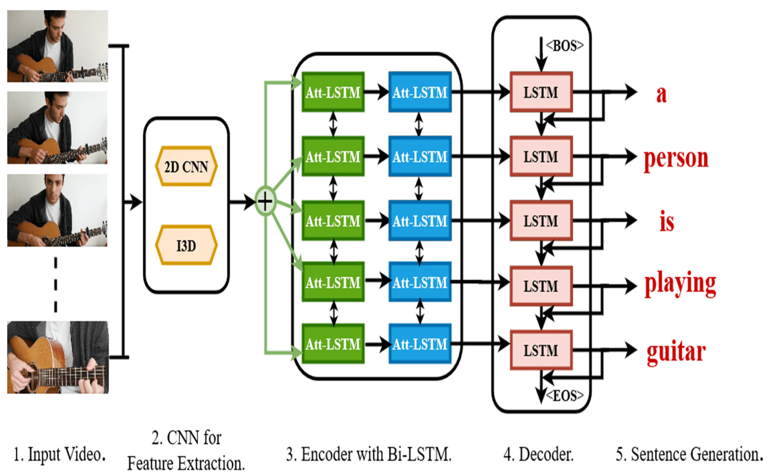
RNN Long Short Term Memory (LSTM)
Long Short-Term Memory (LSTM) is a variant of a recurrent neural network capable of retaining and using past information for a longer period. USE CASE:
Pattern Recognition
State-of –the-Art -Time Series Analysis Predictive Analytics Widely used in Machine translation
Predictive Search
Image Captioning

Slide 17
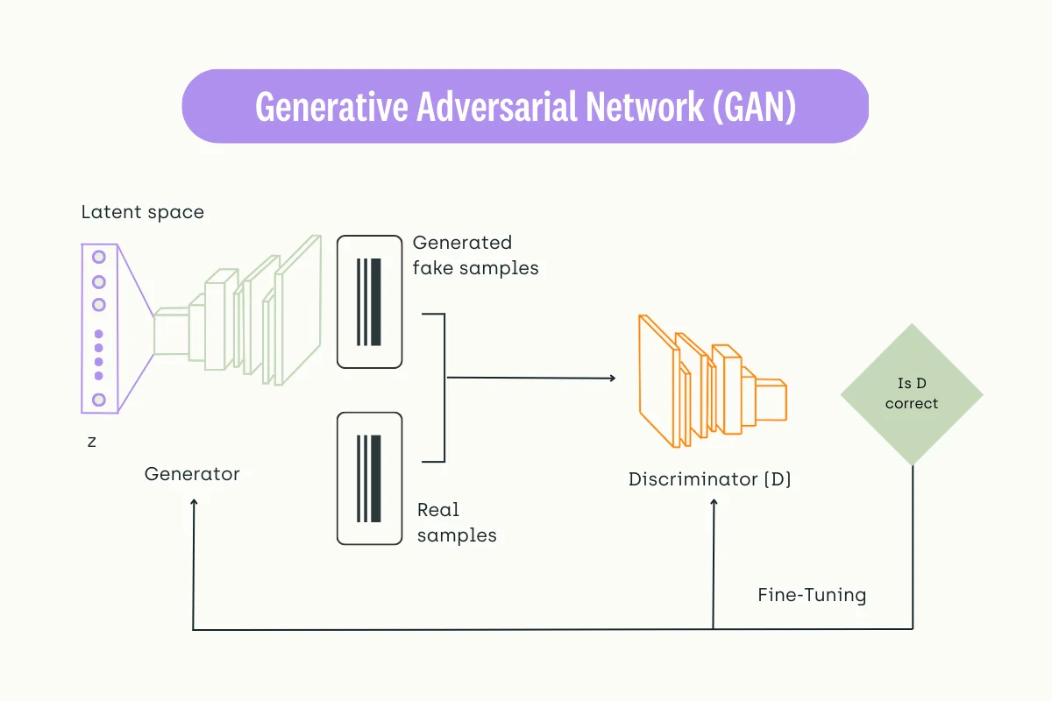
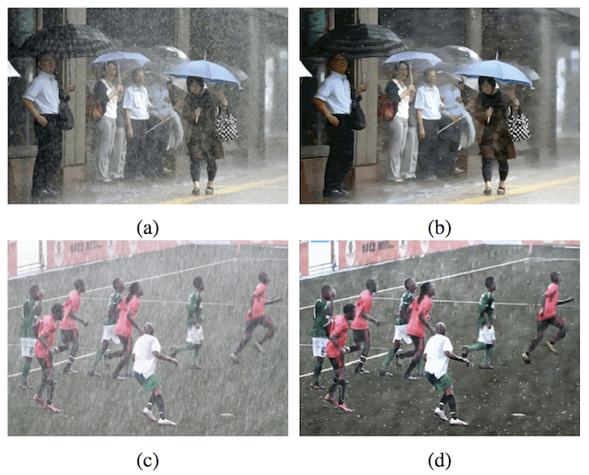
Generative Adversarial Network (GANS)
GANS: An architecture which has Generator and
Discriminator to generate and evaluate the data. EXAMPLE USE CASE:
Style Transfer
Deep Fakes
Augmentation/ Image Reconstruction
Image Synthesis
Example of Using a GAN to Remove Rain From PhotographsTaken from Image De-raining Using a Conditional Generative Adversarial Network

Slide 18
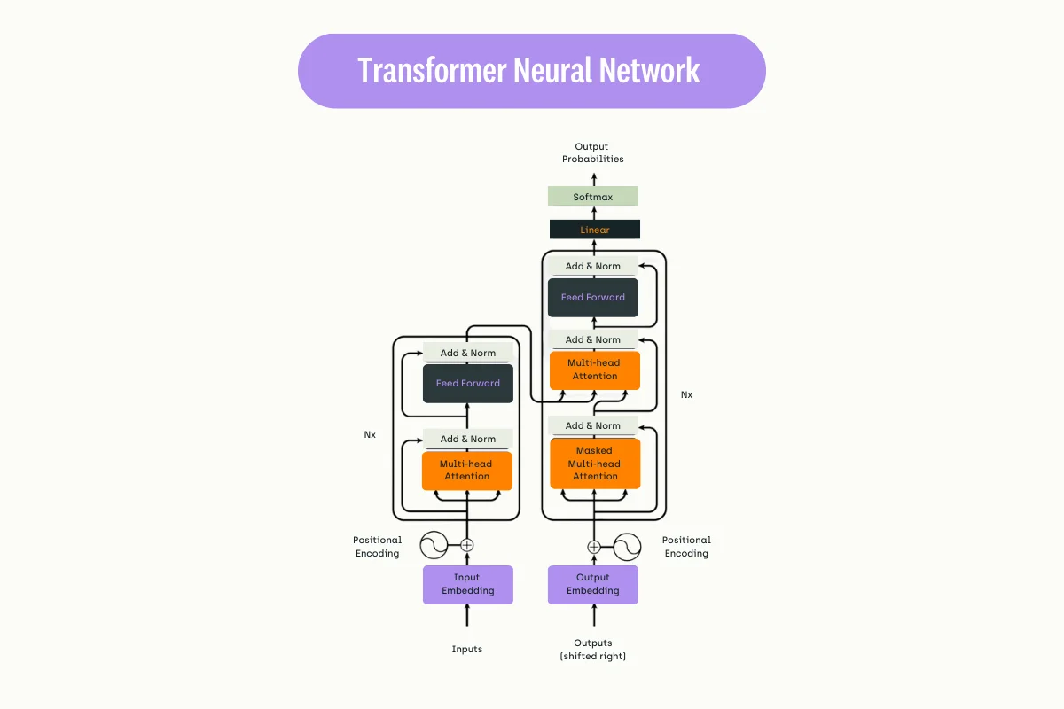
TRANSFORMER
The transformer is a deep-learning architecture introduced in 2017. Today, it powers many advanced AI software, particularly in the NLP field like ChatGPT, BERT, GPT 4, Gemini and many more. USE CASE:
Natural Language Generation
Natural Language Understanding
Translation
Summarization

Slide 19
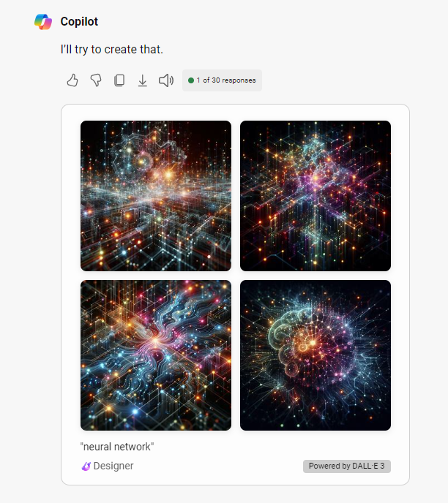
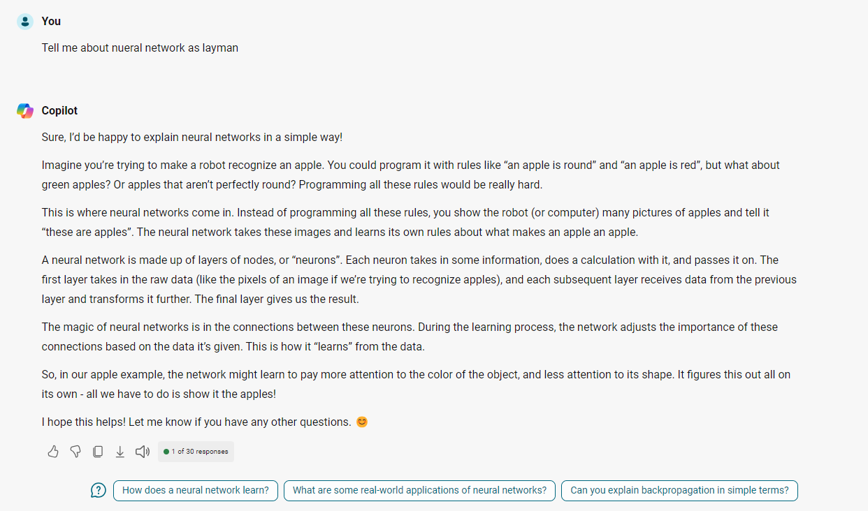
EXAMPLE TRANSFORMER

Slide 20
REFERENCES
https://arxiv.org/abs/1706.03762 (Attention is All you need paper)
https://github.com/3b1b/manim (Manim Library)
https://kili-technology.com/data-labeling/machine-learning/neural-network-architecture-all-you-need-to-know-as-an-mle-2023-edition (NN Architectures)
https://www.youtube.com/watch?v=aircAruvnKk (3 Blues 1 Brown: Neural Net)
https://www.youtube.com/watch?v=Ilg3gGewQ5U (Blues 1 Brown: Backward Propagation)
https://arxiv.org/abs/1406.2661 (GANs)
https://www.mdpi.com/2076-3417/12/1/317 (LSTM)
https://www.tensorflow.org/tutorials/images/cnn (CNN)

Slide 21
Thank You

